Slide 1
Interrupts In General

Slide 2
AGENDA
What is an Interrupt ?/Definition of an Interrupt.
Types of Interrupts
Non Spurious Interrupts
Spurious Interrupts
Hardware Interrupts
Software Interrupts
Maskable Interrupts
Non Maskable Interrupts
Terminologies related to Interrupts Discussion
Interrupt Service Routine/Interrupt Sub-Routine(ISR)/Interrupt Handler
Interrupt Vector
Interrupt Vector Table
Interrupt Latency (Time)
Interrupt Response Time
Interrupt Recovery Time

Slide 3
What is an Interrupt ?
Interrupt is a signal/event given to any CPU to break its normal flow of execution and redirect to another flow of execution with higher priority than the current flow of execution.And after completing the flow of execution with higher priority return back and continue with its normal flow of execution.
Types of Interrupts :
Non Spurious Interrupts : Refers to Interrupts any CPU which have be designed to be handled /entertained by CPU when such interrupt occur.
Spurious Interrupts : Refers to Interrupts which may occur in any CPU but the CPU has not be designed to handle/entertain such interrupts.
Hardware Interrupts : Refers to Interrupts which can be Generated by External Devices/Peripheral / OnChip Peripherals onto the CPU. And these these types of interrupts can also be referred to as Asynchronous Interrupts.

Slide 4
Software Interrupts : Refers to Interrupts which can be Generated by CPU when it is executing a particular instruction during flow of execution. These types of interrupts occurs in an orderly/predictible way. And hence can also be referred to as Synchronous Events. And these are in someway similar to Calling of Sub-Routines But Normal Sub-Routines are handled And How Interrupt Sub-Routines are Handled differ slightly.
Conclusion : The Hardware & Software Interrupt Mentioned Above are all termed as Non Spurious Interrupts.
Maskable Interrupts – are those set of interrupts within/supported by CPU which can be blocked/ignored and also unblocked/considered for being serviced or not. Here the programer has the privilidge to configure the interrupts to be blocked/unblocked. (USER/Peripheral Interrupts)
Non Maskable Interrupts – are those interrupts which cannot be blocked by the programmer & will definitely be serviced when such interrupts are raised. (RESET for any CPU)

Slide 5
Terminologies Of Interrupts
Interrupt Service Routine/Interrupt Sub Routine/Interrupt Handler (ISR) – refer to a block of statements/code defined somewhere in code/rom section which executes in response to a particular interrupt raised onto CPU.
Interrupt Vector – refers to usually a predefined location in the code/rom section from where the particular ISR MUST begin from because when interrupt is raised the CPU is automatically/by default redirected to branch to that (interrupt vector)location to start ISR execution.
Sometime Collection/Set of Interrupt Vectors are exclusive stored in predefined locations with respect to CPU architecture(s) and the definition for ISR can be stored in any area of Code/ROM section.
Interrupt Vector Table – Refers to the Collection of Interrupt Vectors (i.e is addresses/instruction direction the CPU to branch to definition of ISR place else where in the code/rom section.
Sometime in Some CPU architecture(s) the Interrupt vectors & ISRs can be both merged in these predefined location.

Slide 6
Interrupt Latency (Time) – Refers to the time lapse/gap between when the interrupt was raised onto the CPU and when did the CPU actually see/sense/check/poll that interrupt signal is available.
Interrupt Response Time – Refers to the ILT + Time for Context Saving (Context Switch) (Default Context Saving + User Define Context Saving)+Time to Executing the 1st Instruction related to the activity of ISR.

Slide 7
Context Saving (Context Switching) –refers to saving/pushing of return address,certain registers & flags information onto stack,because those registers & flags may be also required in the ISR,and after completing the ISR the return address helps returning back to the suspended normal flow of execution with the registers & flag restored to continue with. Context Saving Operation consumes time which should be also considered.
Interrupt Recovery Time – Refer to Time of Context Retrieving (Context Switch) & continuing from the point where normal flow of execution was suspended from.
Context Retrieving (Context Switching) – refers to poping/retrieving the certain registers & flags information & return address to get back/resume
execution from the point where it was suspended in the normal flow of execution.

Slide 8
Interrupt Structure Of
Intel’s 8051 Architecture

Slide 9
Interrupt System
6 Interrupt Sources (default order of priority)
      RESET
      External Interrupt 0
      Timer 0
      External Interrupt 1
      Timer 1
      UART –Serial (TX/RX) Interrupts

Slide 10
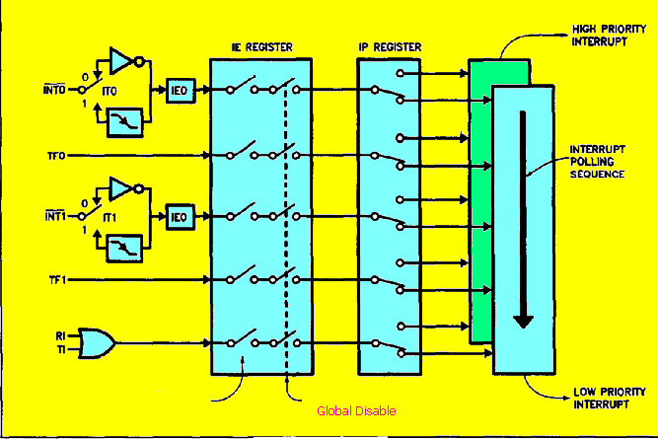
Interrupt

Slide 11
Polling:
Main()
{
some instructions
while(1)
{
------
------
------
------
if(sw is pressed)
{
-------
-------
}
--------
--------
}
}
Interrupt:
Void interrupt service routine
{
----
----
}
Main()
{
some instructions
while(1)
{
------
------
------
------
------
-----
}
}

Slide 12
Interrupt System
Each interrupt type has a separate vector address
Each interrupt type can be programmed to one of two priority levels
External interrupts can be programmed for edge or level sensitivity

Slide 13
IE : Interrupt Enable Register
EA ---- ET2 ES ET1 EX1 ET0 EX0
EA : Global interrupt enable
ES : Serial interface
ET1 : Timer 1
EX1 : External interrupt 1
ET0 : Timer 0
EX0 : External interrupt 0
0 = Disabled
1 = Enabled

Slide 14
Interrupt Vector Addresses
Source Address
RESET 0000H
IE0 0003H
TF0 000BH
IE1 0013H
TF1 001BH
RI&TI 0023H
The 8051 starts execution at 0000H after Reset

Slide 15
IP : Interrupt Priority Register
----- ----- PT2 PS PT1 PX1 PT0 PX0
PS : Serial interface
PT1 : Timer 1
PX1 : External interrupt 1
PT0 : Timer 0
PX0 : External interrupt 0
0 = Low priority
1 = High priority

Slide 16
Interrupt Handling
During An On Ongoing Instruction (of 1MC/2MC/4MC) is executing and any interrupt is raised before/on S5P2 of any MC,then interrupt is seen by CPU.
CPU Completes the Ongoing Instruction.
Save Return Address of Next Instruction available/pointed by PC saved onto Stack(using Push Operations PUSH PCL, PUSH PCH)-this is called “Default Context Saving”
Perform an LCALL to Interrupt Vector thereby branching to ISR
Executes statements with ISR until Last statement (RETI)
On RETI Instruction Being Executed ,CPU Retreives Return Address from Stack(using POP PCH,POP PCL) into PC – this is called “Default Context Retreiving” and hence making CPU to Continue from where it was suspended in main-line execution flow.

Slide 17
Reset
Non maskable interrupt
Atleast high for 2 machine cycles
Reset address - 0000h
Bank 0 is selected
Internal RAM contents may change

